Slide 1
Translation of Expressions
Translation of expressions into three-address code
An expression with more than one operator, like a + b * c, will translate into instructions with at most one operator per instruction.
The compiler decides the order of operation given by three address code.
Three address code is a linearized representation of a syntax tree, where the names of the temporaries correspond to the nodes.

Slide 2
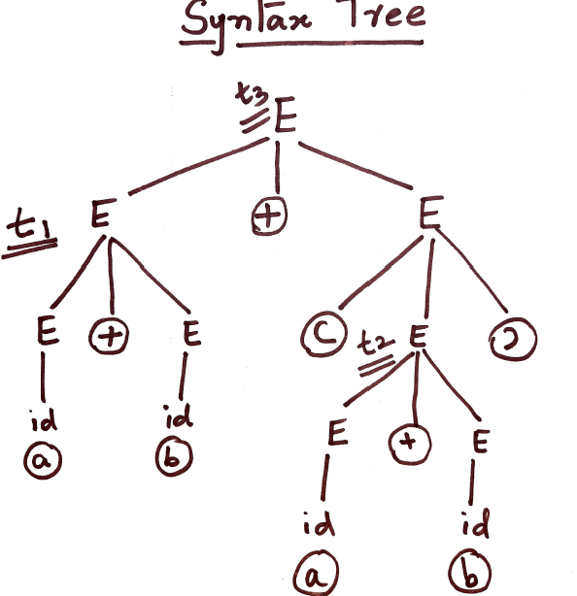
Three Address Code for a + b + ( a + b )
t1=a + b
t2=a + b
t3=t1 + t2

Slide 3
Operations within Expressions
Attributes S.code and E.code denote the three-address code for S and E, respectively.
Attribute E.addr denotes the address that will hold the value of E. An address can be a name, a constant, or a compiler-generated temporary.
The notation gen(x = y + z) to represent the three-address instruction x = y + z. Expressions appearing in place of variables like x, y, and z are evaluated when passed to gen, and quoted strings like “=“ are taken literally.
In syntax-directed definitions, gen builds an instruction and returns it. In translation schemes, gen builds an instruction and incrementally emits it by putting it into the stream of generated instructions.
A sequence of distinct temporary names t1,t2, … is created by successively executing new Temp().
E.addr to point to the symbol-table entry for the instance of id. Let top denote the current symbol table. Function top.get retrieves the entry when it is applied to the string representation id.lexeme of the instance of id. E.code is set to the empty string.

Slide 4
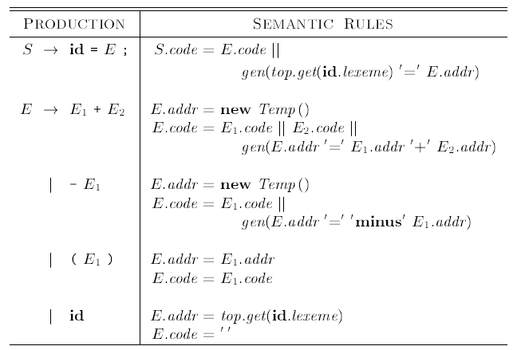

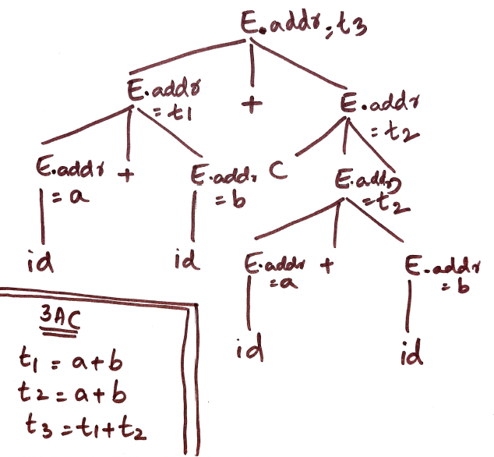
Three-address code for expressions

Slide 5
Generate Three Address Code for the following using Translation Scheme
a = a + -b - a + -b

Slide 6
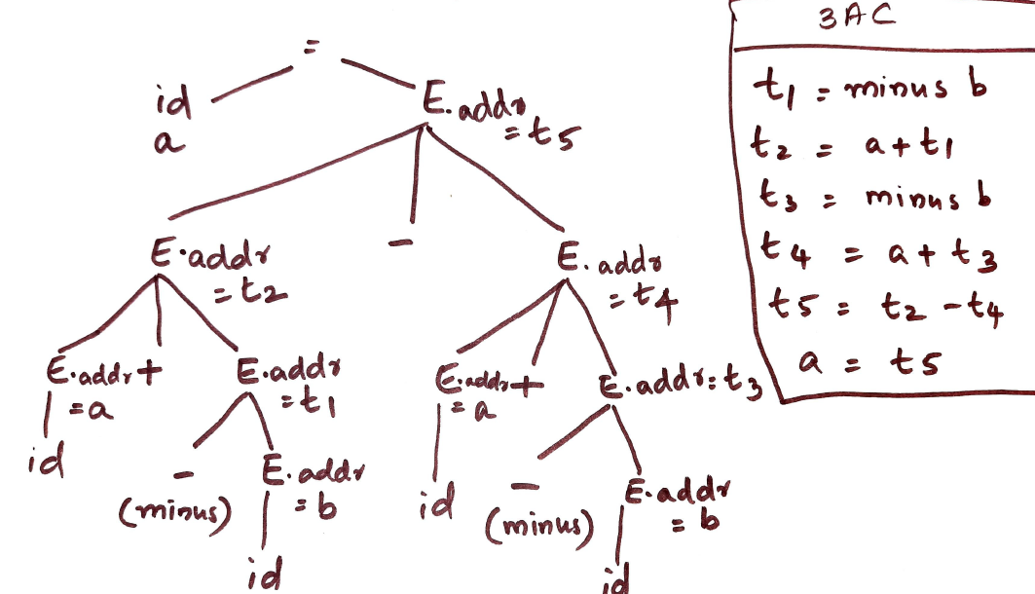

Slide 7
Incremental Translation
Code attributes can be long strings, so they are usually generated incrementally.
Thus, instead of building up E.code generate only the new three-address instructions, as in the translation scheme.
In the incremental approach, gen not only constructs a three-address instruction, it appends the instruction to the sequence of instructions generated so far. The sequence may either be retained in memory for further processing, or it may be output incrementally.
Here, attribute addr represents the address of a node rather than a variable or constant.

Slide 8
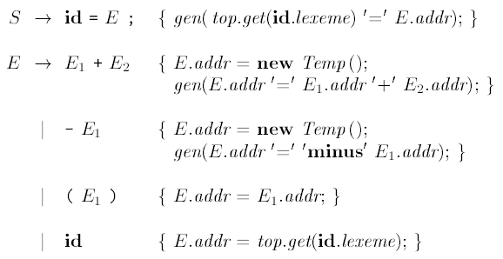
Generating three-address code for expressions incrementally

Slide 9
Answer the question
The least number of temporary variables required to create a three-address code in static single assignment form for the expression
q + r/3 + s – t * 5 + u * v/w is _______________ ?
Answer: 8

Slide 10
Next session on 9/4/2020
Addressing array elements

